Slide 1














PCOS Diagnosis System
Presented by
Mariam Osama
Reem Fayez
Tasneem AlaaEldin
Omar Arafa

Slide 2
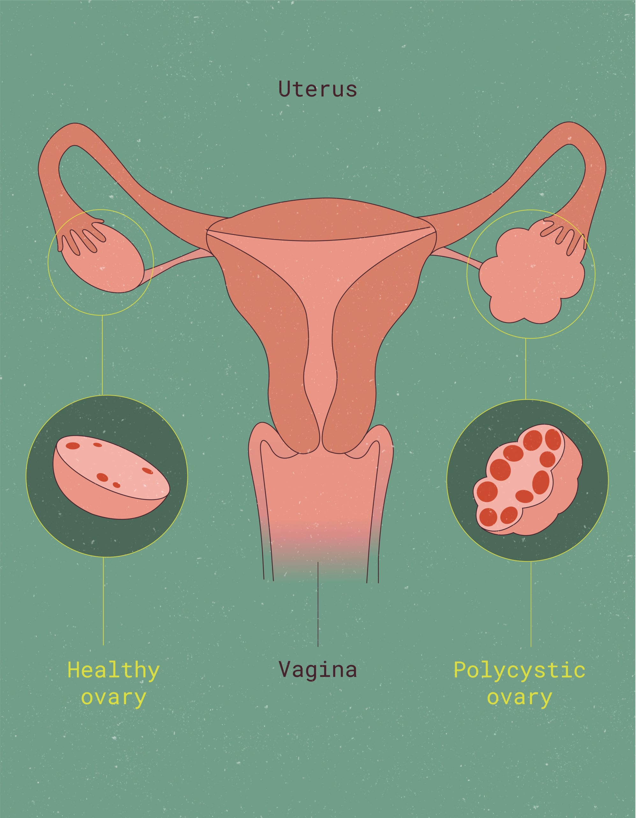
Introduction
Because PCOS is a complex disorder that can present with a variety of ovarian and metabolic abnormalities, it is laborious and prone to human error to detect with traditional diagnostic techniques.
This project successfully integrates multiple machine learning models to create an efficient system for diagnosing Polycystic Ovary Syndrome (PCOS) from MRI images.

Slide 3
Methodology
1. Data Collection and Preprocessing
2. Model Training and Evaluation
3. Testing and Validation
4. Deployment and Integration
5. Continuous Improvement

Slide 4
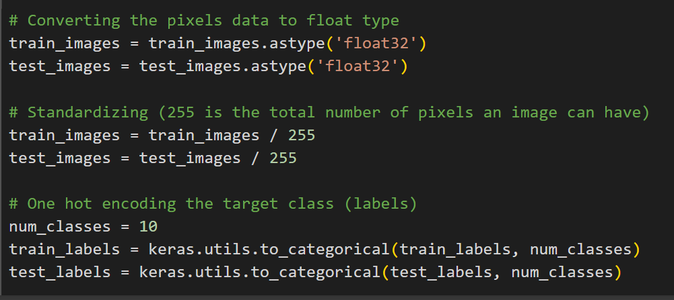
1. Data Collection and Preprocessing
Standardizing/Normalizing is to convert all pixel values to values between 0 and 1.
converting type to float to normalize correctly.
using to_categorical is that the loss function that we will be using in this code (categorical_crossentropy) when compiling the model needs data to be one hot encoded.

Slide 5
2. Model Training and Evaluation
Four machine learning models are trained: a feedforward neural network (NN) for flattened data, k-Nearest Neighbors (KNN) for pattern recognition, a Convolutional Neural Network (CNN) to capture spatial features, and a Support Vector Machine (SVM) for binary classification. The models are trained on the preprocessed dataset, and their performance is evaluated using accuracy.

Slide 6
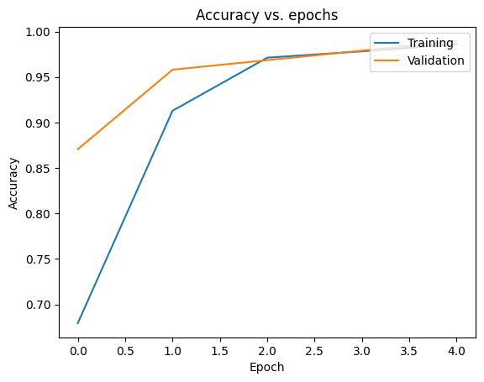
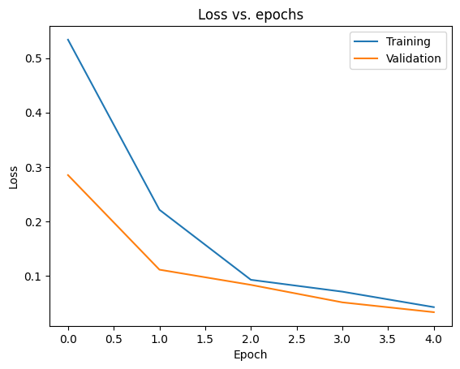
3.Testing and Validation
The model demonstrates consistent performance with loss decreasing and accuracy increasing for both training and validation. This is an indicator of a well-trained model with no significant overfitting or underfitting issues.

Slide 7
6. Continuous Improvement
Model Optimization: Refining algorithms (hyperparameters, layers, activation functions).
Dataset Enhancement: Expanding and preprocessing ultrasound datasets.
Feature Engineering: Extracting meaningful features for better predictions.
Validation: Ensuring generalizability through testing on dataset.
Documentation: Recording changes and reflecting on lessons learned.

Slide 8
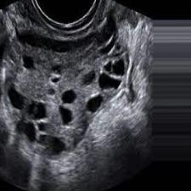
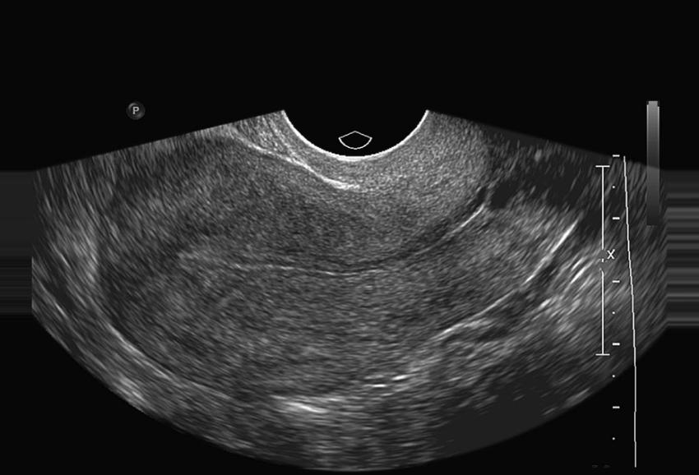
Results
Integrated four distinct machine learning models (NN, KNN, CNN, SVM) for accurate diagnosis.
Achieved high diagnostic accuracy by evaluating performance.
Gained hands-on experience in image processing and model optimization for medical applications.

Slide 9
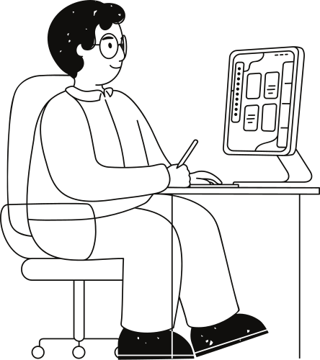
Conclusion
Ultimately, this project provides a comprehensive methodology for automated medical image classification and showcases how machine learning can be leveraged to improve healthcare diagnostics, offering valuable insights that can be extended to other medical applications. Deployed the trained models into clinical workflows, enhancing real-world usability.

Slide 10
Future Work & Suggestions
IMPLEMENTING DYNAMIC GUI THAT WOULD BE MORE EASIER AND USER FRIENDLY TO DEAL WITH.

Slide 11
Thank you!
Any Questions?

